Slide 1
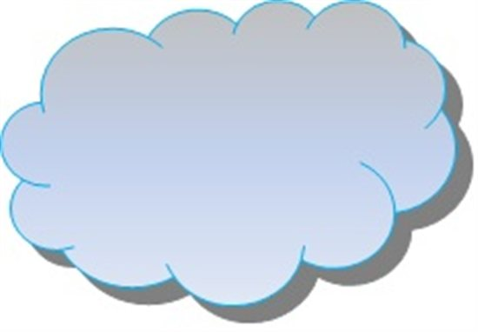
dbGaP File Access on C3DDB
General Login Nodes
Compute Nodes
Non-dbGaP
dbGaP
Non-dbGaP
dbGaP File System
Router Firewall IDS
MIT subnet
Private non-routable
IP network
(running over the Infiniband fabric)
Public Internet
Lustre Servers and Storage
Non-dbGaP File Systems
NAT
(AKA gateway) Node
Restricted
Login Nodes
dbGaP
Non-dbGaP
Notes
1. The dbGaP file system is only mounted by compute nodes and restricted login nodes
2. To access a file in the dbGAP file system, one must be logged in to a Restricted Login Node and have group access privileges for the file
3. To log in to a Restricted Access node one must first log in to a General Login Node, then make an SSH connection to a Restricted Login Node

Slide 2
Open Items
How many restricted login nodes?
Need to add the non-MIT internet path
Administration
Security Administrator for C3DDB
Process for granting dbGaP accounts

